Slide 1
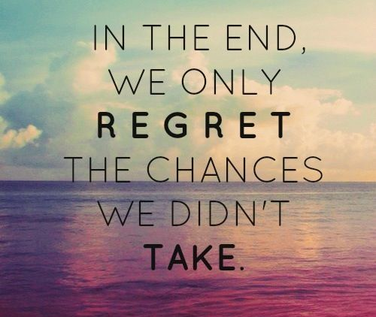
Will I regret not doing this?
Overcoming fear
Push the limits
Culture
Adrenaline
Christopher Bauman – www.chrisbauman.com.au

Slide 2
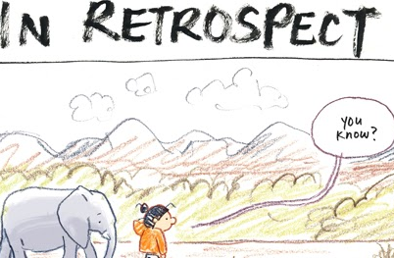
Distinct fears
Push the limits
Culture
Adrenaline
Comfort Zone
Regret
opportunity
Christopher Bauman – www.chrisbauman.com.au

